Slide 1
Book1
File created on: 1/10/20 8:46:25 AM EST

Slide 2
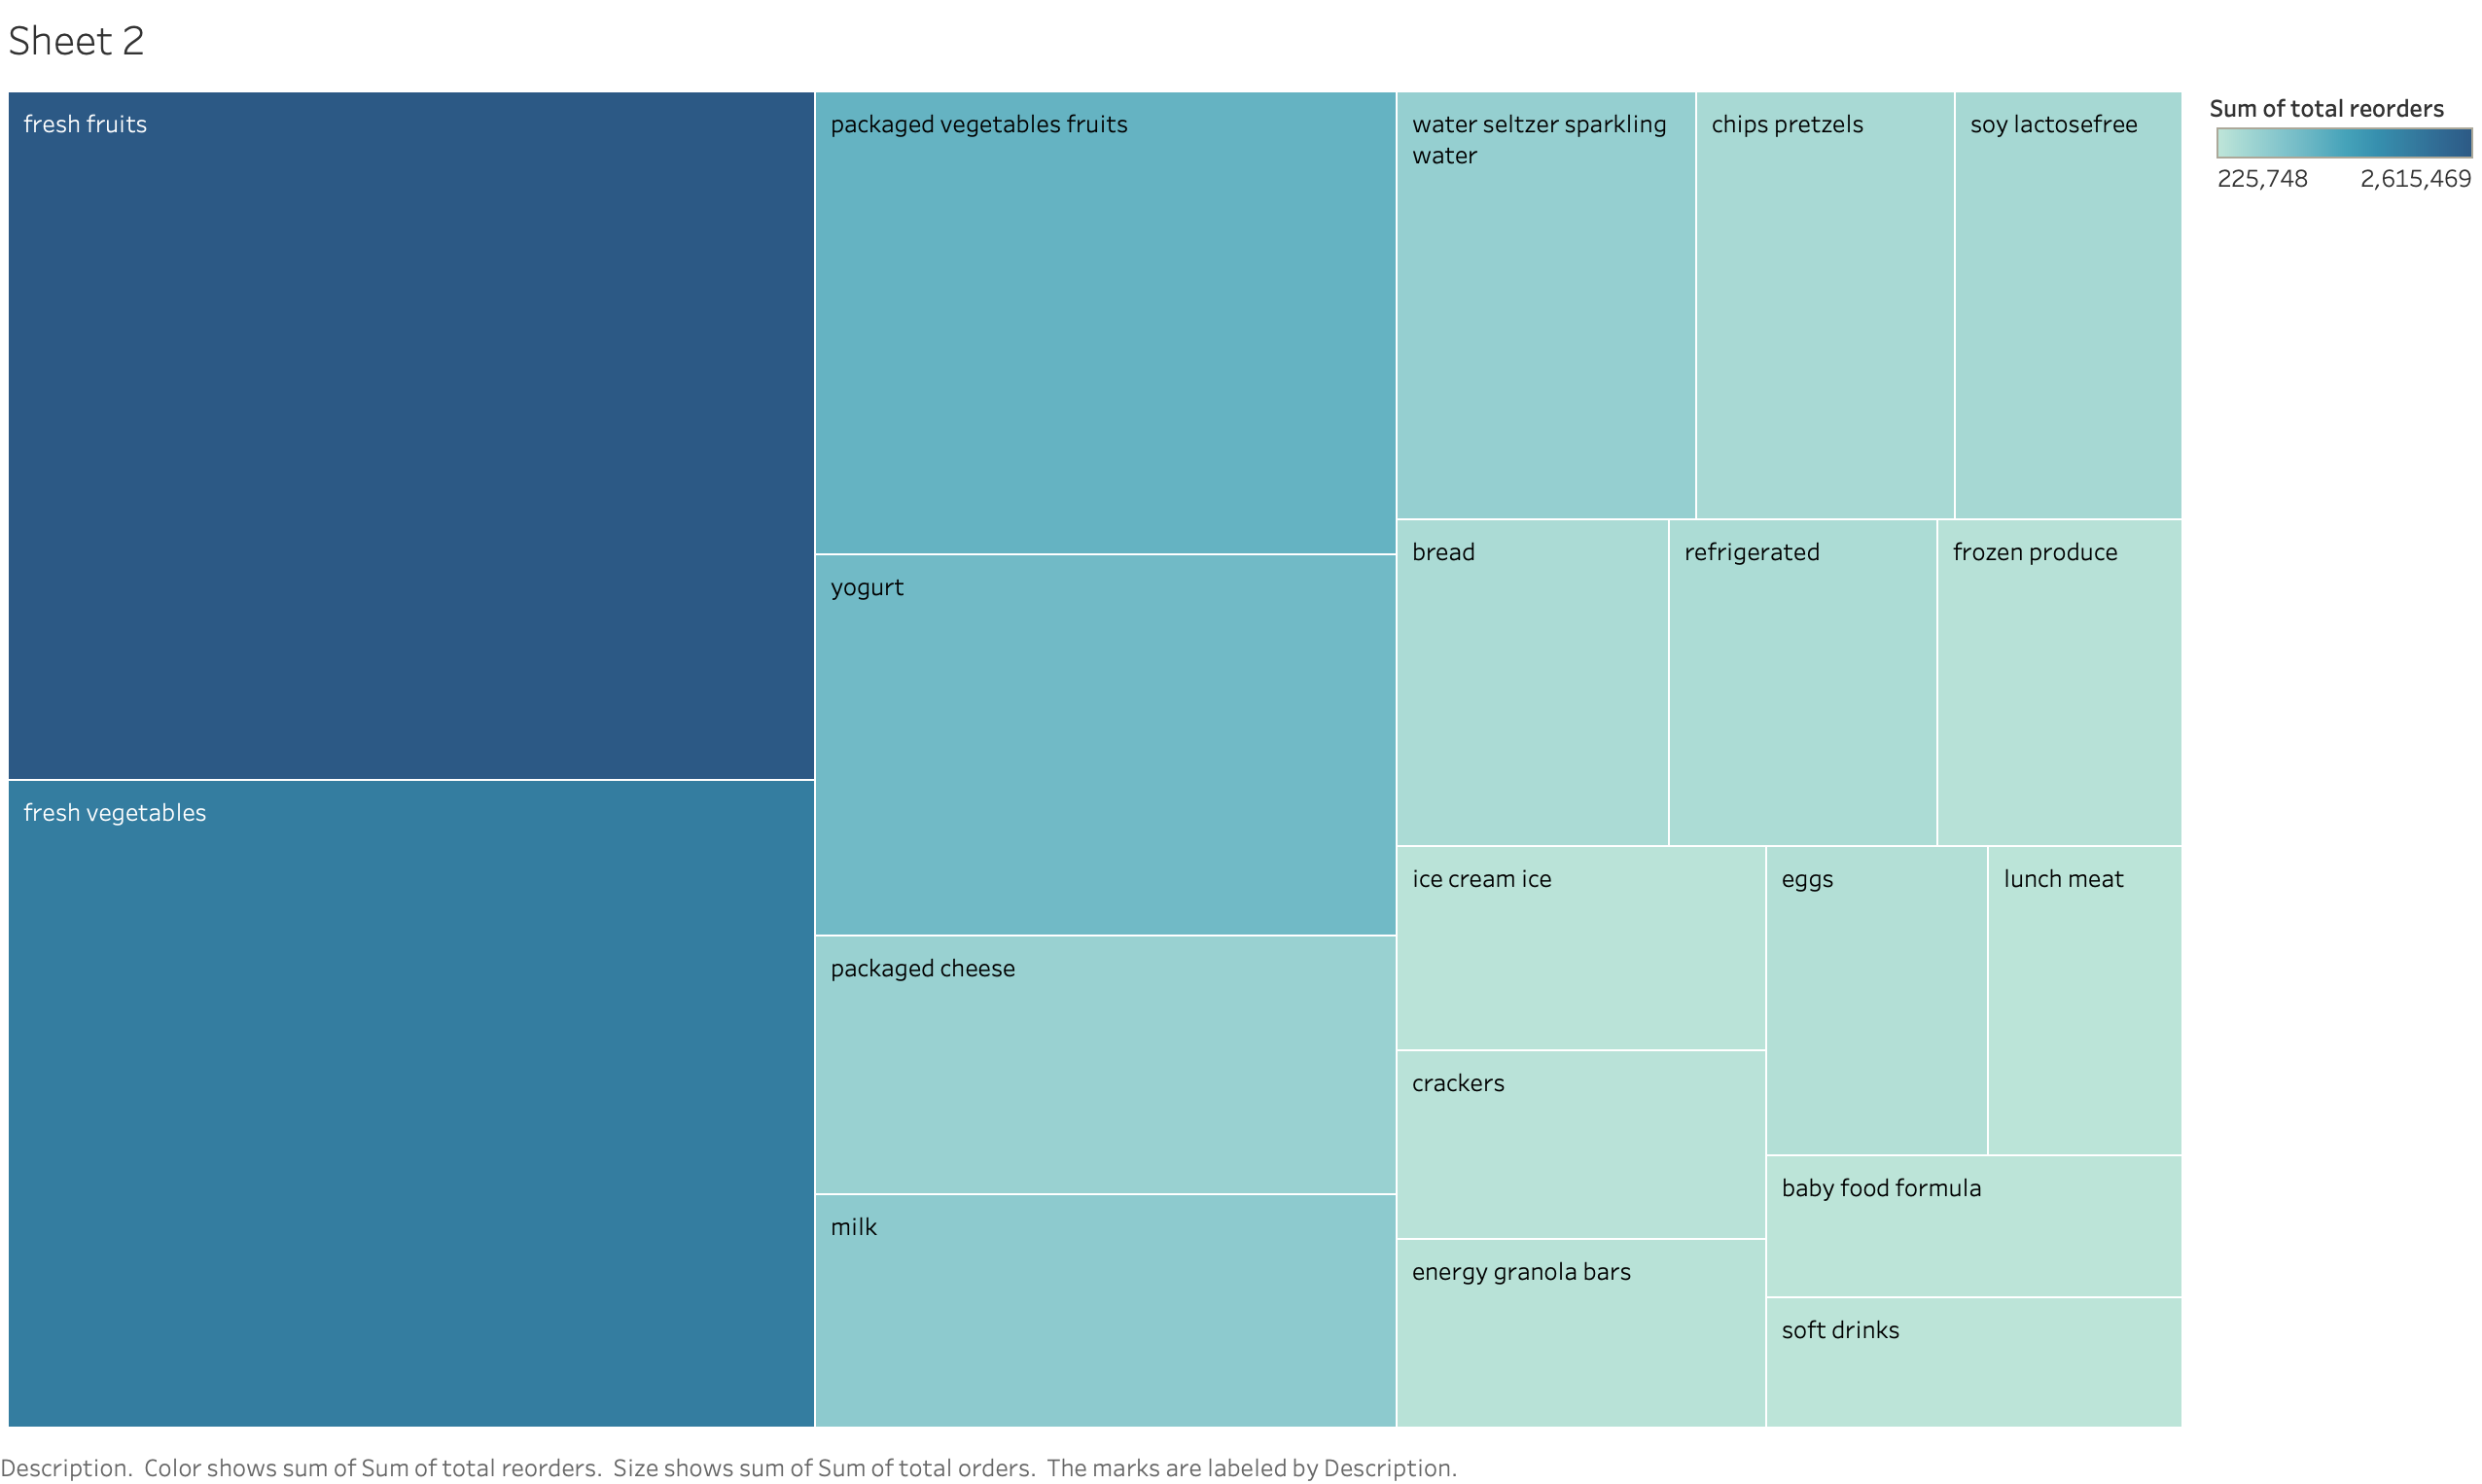

Slide 3
